Slide 1
DESIGN AND ANALYSIS OF ALGORITHMS
Dr Tathagata Ray, BITS- Pilani

Slide 2
Minimal Spanning Trees

Slide 3
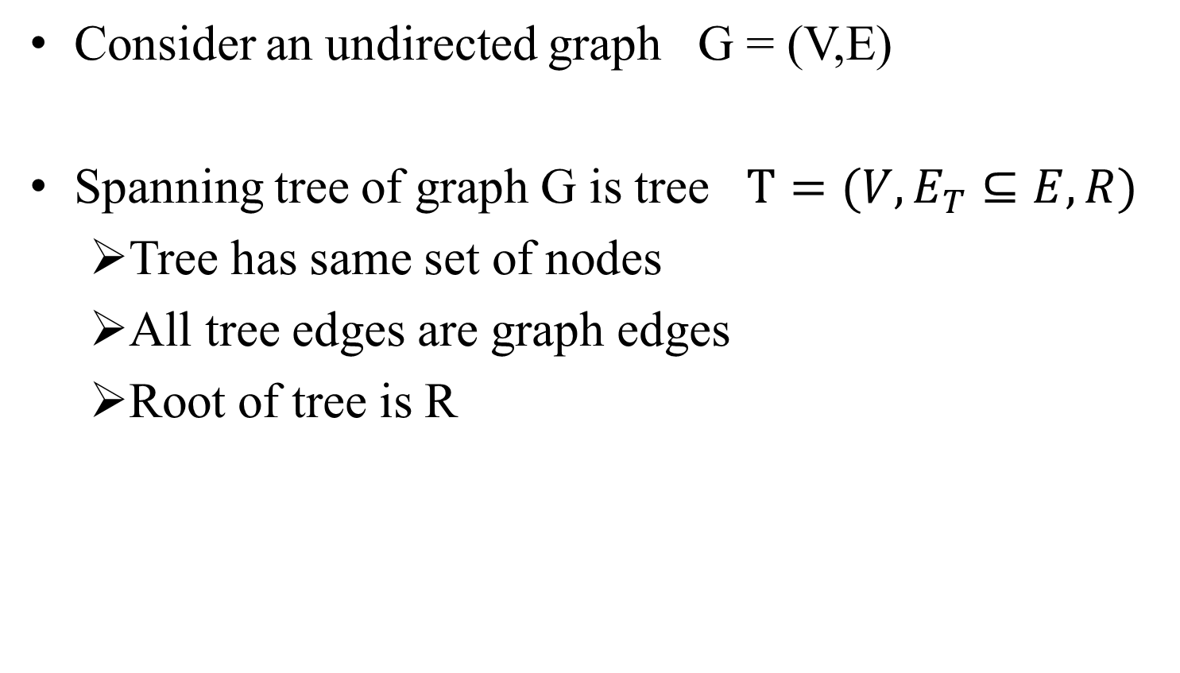
Spanning Tree

Slide 4
Spanning trees
1
0
A
B
A
1
B
2
9
G
G
5
2
F
3
7
8
F
C
C
I
H
I
H
6
D
E
4
D
E
Breadth-first Spanning Tree
Depth-first spanning tree

Slide 5
Property 1 of spanning trees
Graph: G = (V,E) , Spanning tree: T = (V,E_{T},R)
For any edge c in G but not in T, there is a simple cycle containing only edge c and edges in spanning tree.
edge (I,H):
simple cycle is (I,H,G,I)
edge (H,C):
simple cycle is (H,C,B,A,G,H)
Proof?
A
B
G
F
C
I
H
E
D

Slide 6
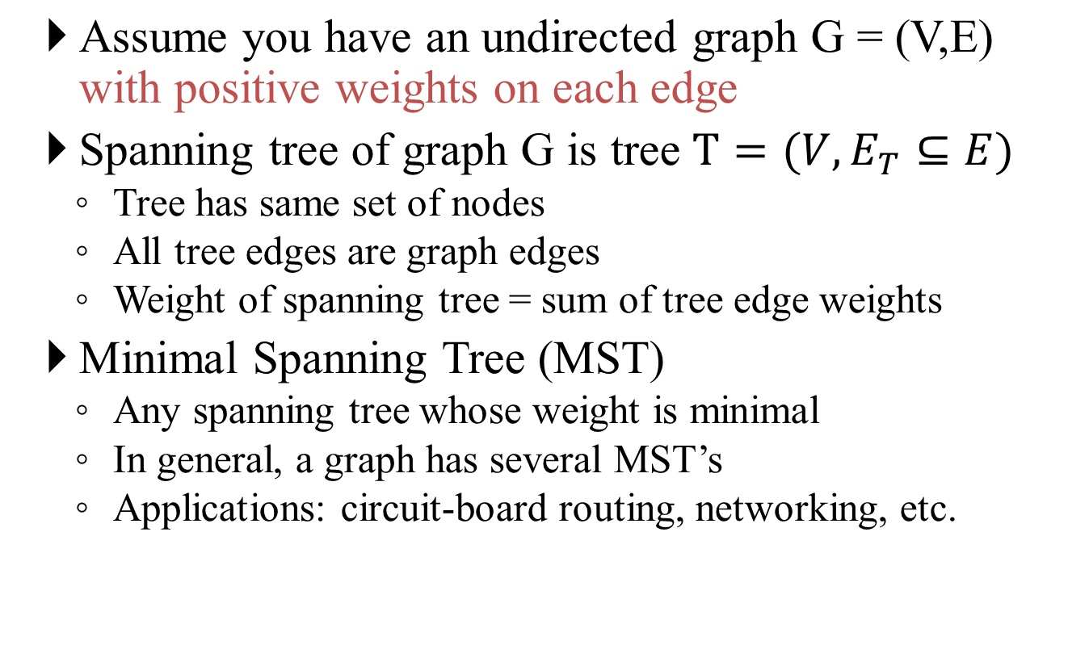
Weighted Spanning Trees

Slide 7
Example
A
2
B
A
2
B
9
5
G
6
4
9
5
G
6
4
F
1
2
5
F
1
2
5
5
C
5
C
6
3
I
4
H
1
6
3
I
4
H
1
2
2
E
1
D
E
1
D
Graph
SSSP tree
A
2
B
9
5
G
6
4
F
1
2
5
5
C
Minimal spanning tree
6
3
I
4
H
1
2
E
1
D

Slide 8
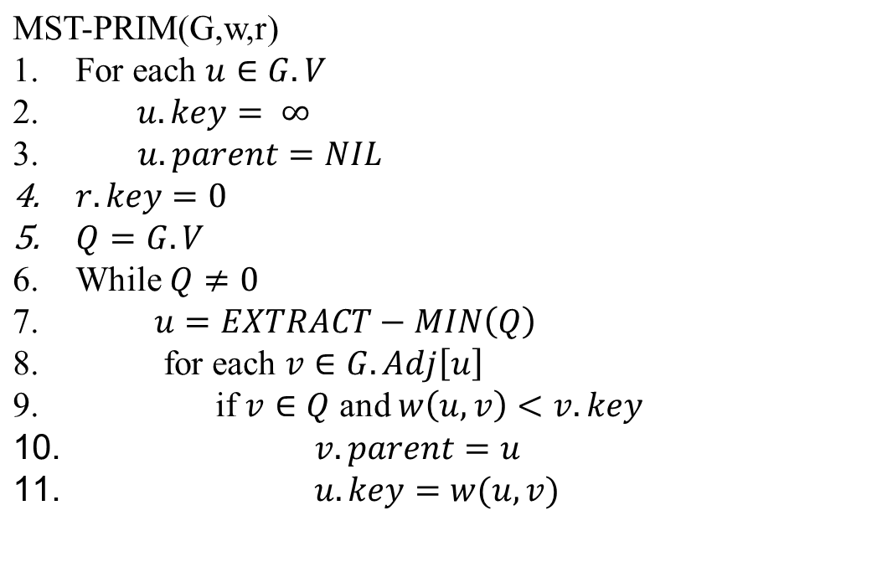
Prim’s MST algorithm

Slide 9
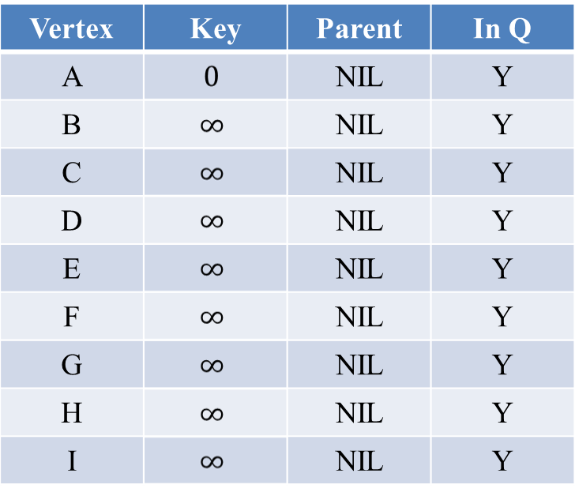
Steps of Prim’s algorithm
A
2
B
9
5
G
6
4
F
1
2
5
C
5
6
3
I
4
H
1
2
E
1
D

Slide 10
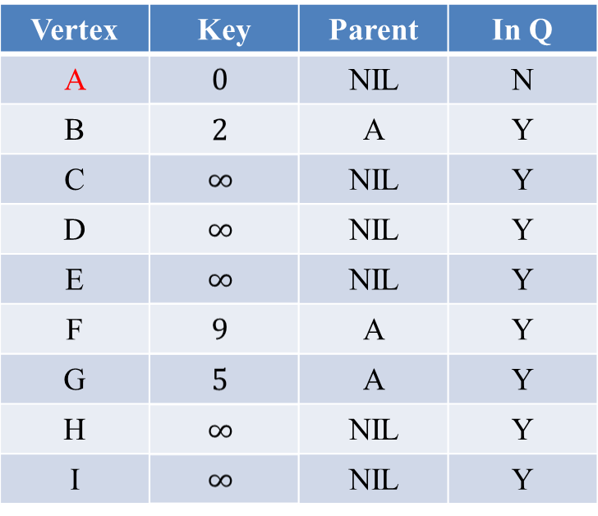
Steps of Prim’s algorithm
A
2
B
9
5
G
6
4
F
1
2
5
C
5
6
3
I
4
H
1
2
E
1
D

Slide 11
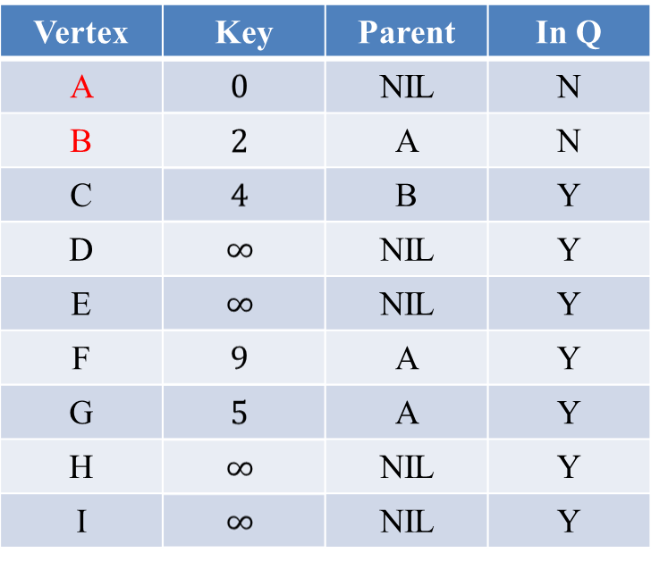
Steps of Prim’s algorithm
A
2
B
9
5
G
6
4
F
1
2
5
C
5
6
3
I
4
H
1
2
E
1
D

Slide 12
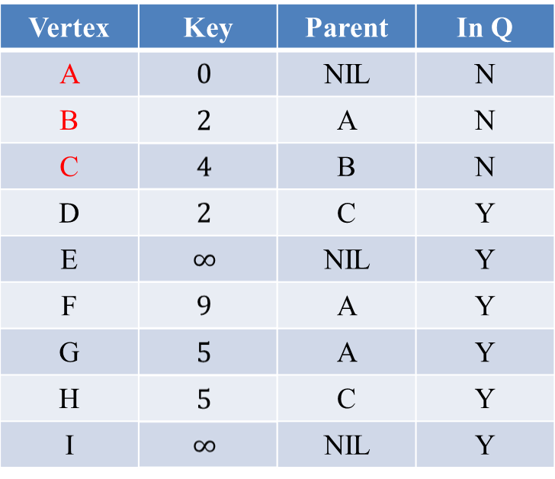
Steps of Prim’s algorithm
A
2
B
9
5
G
6
4
F
1
2
5
C
5
6
3
I
4
H
1
2
E
1
D

Slide 13
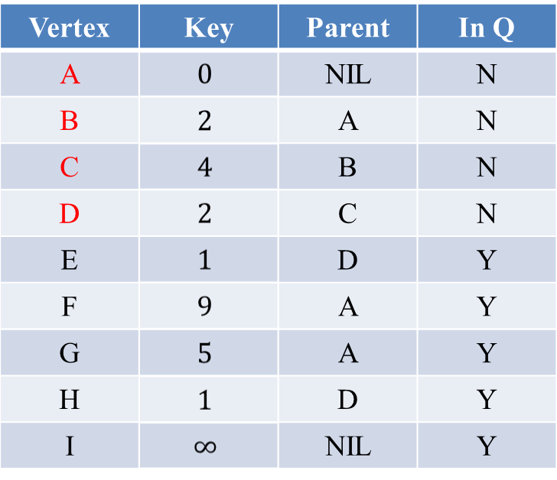
Steps of Prim’s algorithm
A
2
B
9
5
G
6
4
F
1
2
5
C
5
6
3
I
4
H
1
2
E
1
D

Slide 14
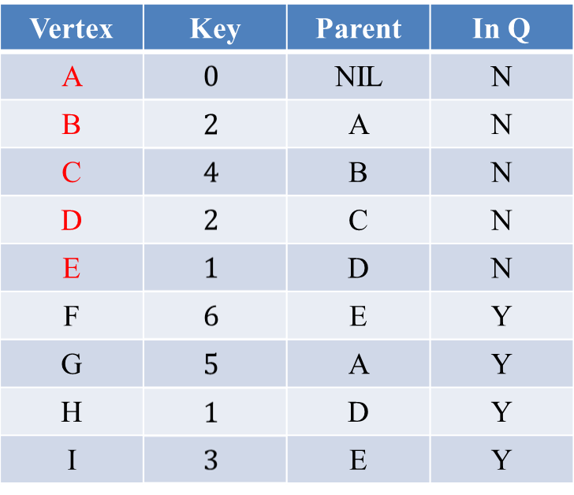
Steps of Prim’s algorithm
A
2
B
9
5
G
6
4
F
1
2
5
C
5
6
3
I
4
H
1
2
E
1
D

Slide 15
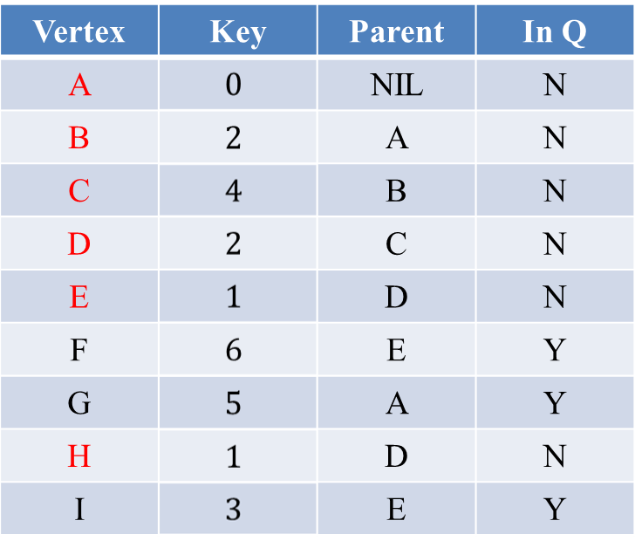
Steps of Prim’s algorithm
A
2
B
9
5
G
6
4
F
1
2
5
C
5
6
3
I
4
H
1
2
E
1
D

Slide 16
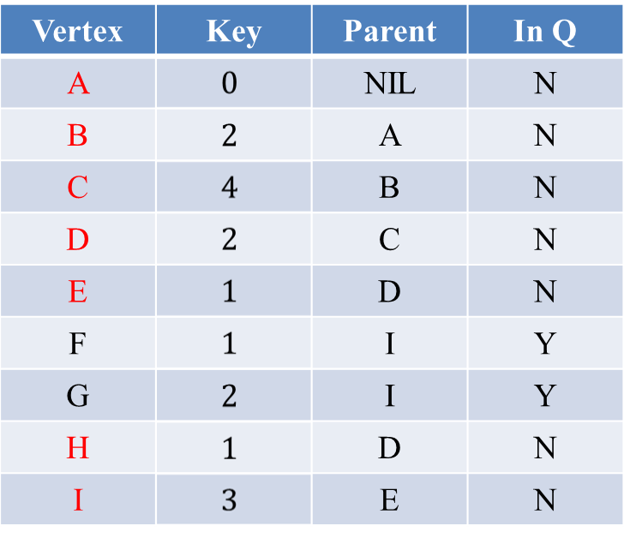
Steps of Prim’s algorithm
A
2
B
9
5
G
6
4
F
1
2
5
C
5
6
3
I
4
H
1
2
E
1
D

Slide 17
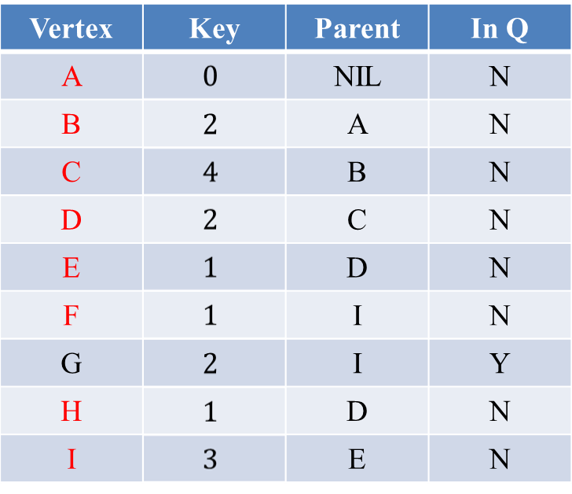
Steps of Prim’s algorithm
A
2
B
9
5
G
6
4
F
1
2
5
C
5
6
3
I
4
H
1
2
E
1
D

Slide 18
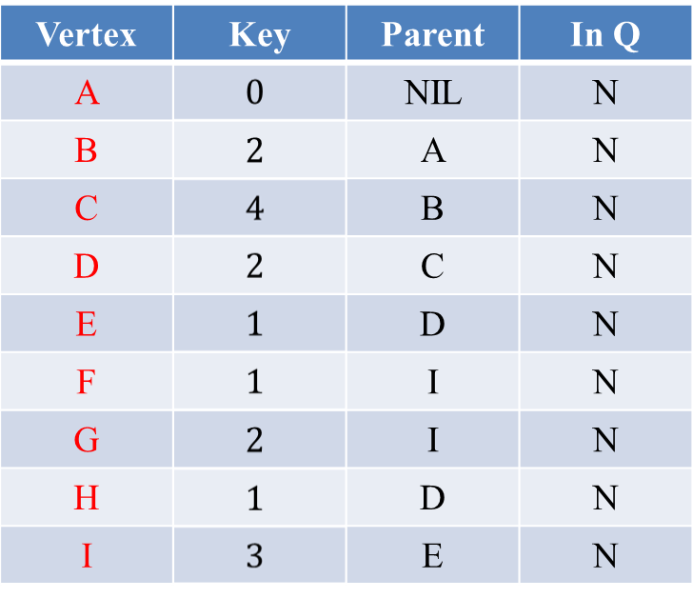
Steps of Prim’s algorithm
A
2
B
9
5
G
6
4
F
1
2
5
C
5
6
3
I
4
H
1
2
E
1
D

Slide 19
Proof of correctness (part 1)
Suppose the algorithm does not produce MST.
Each iteration adds one new node and edge to tree.
First iteration adds the root to tree, and at least that step is “correct”.
  “Correct” means partial spanning tree built so far can be extended to an MST.
Suppose first k steps were correct, and then algorithm made the wrong choice.
  Partial spanning tree P built by first k steps can be extended to an MST M
  Step (k+1) adds edge (u→v) to P, but resulting tree cannot be extended to an MST
  Where to go from here?

Slide 20
Proof (contd.)
Consider simple cycle formed by adding (u→v) to M. Let p be the lowest ancestor of v in M that is also in P, and let q be p’s child in M that is also an ancestor of v. So (p→q) is a bridge edge at step (k+1) as is (u→v). Since our algorithm chose (u→v) at step (k+1), weight(u→v) is less than or equal to weight(p→q).
From Property (3), weight of (u→v) must be greater than or equal to weight(p→q).
p
u
(wrong choice)
u
q
v
v
Partial spanning tree P
Minimal Spanning Tree M

Slide 21
Proof (contd.)
Therefore, weight(p→q) = weight(u→v).
This means that the tree obtained by taking M, deleting edge (p→q) and adding edge (u→v) is a minimal spanning tree as well, contradicting the assumption that there was no MST that contained the partial spanning tree obtained after step (k+1).
Therefore (by induction!), our algorithm is correct.

Slide 22
Prim’s MST algorithm
O(V)
V times
O(lg V)
O(E lg V)
Total Time: O(V lg V + E lg V) = O(E lg V)

Slide 23
Thank you

